Slide 1

Take Another Look at the Numbers
North Carolina State Chapter
P.E.O. Sisterhood
Monday September 28, 2026
7:00 pm – 8:00 pm
President’s Roundtable
Becky Murphy, NC State President
Gina Lindsey, NC State Secretary
1

Slide 2
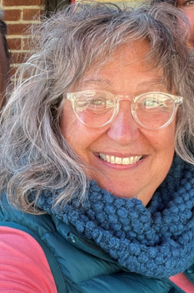
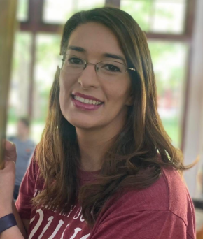
Presenters
Becky Murphy, Chapter AW Gina Lindsey, Chapter AL
State President State Secretary

Slide 3

Increase Participation in
P.E.O. Activities

Slide 4

NC will increase Participation
WIG Strategies
Chapter Vitality Support
End to End Pipeline
Engage Chapters to participate in
m&m Challenge 2.0

Slide 5

The WIG How
Increase Membership by 10%
Decrease Inactives by 20%
Applications for State Service
m&m Challenge: Chapters: 31 62
Activities: 250 500

Slide 6

Participation in Chapter Life
by all Sisters welcomes new energy and shares the tasks
Participation in State level service creates curiosity and commitment
Participation in m&m activities fosters belonging and relationships
CONNECTION

Slide 7
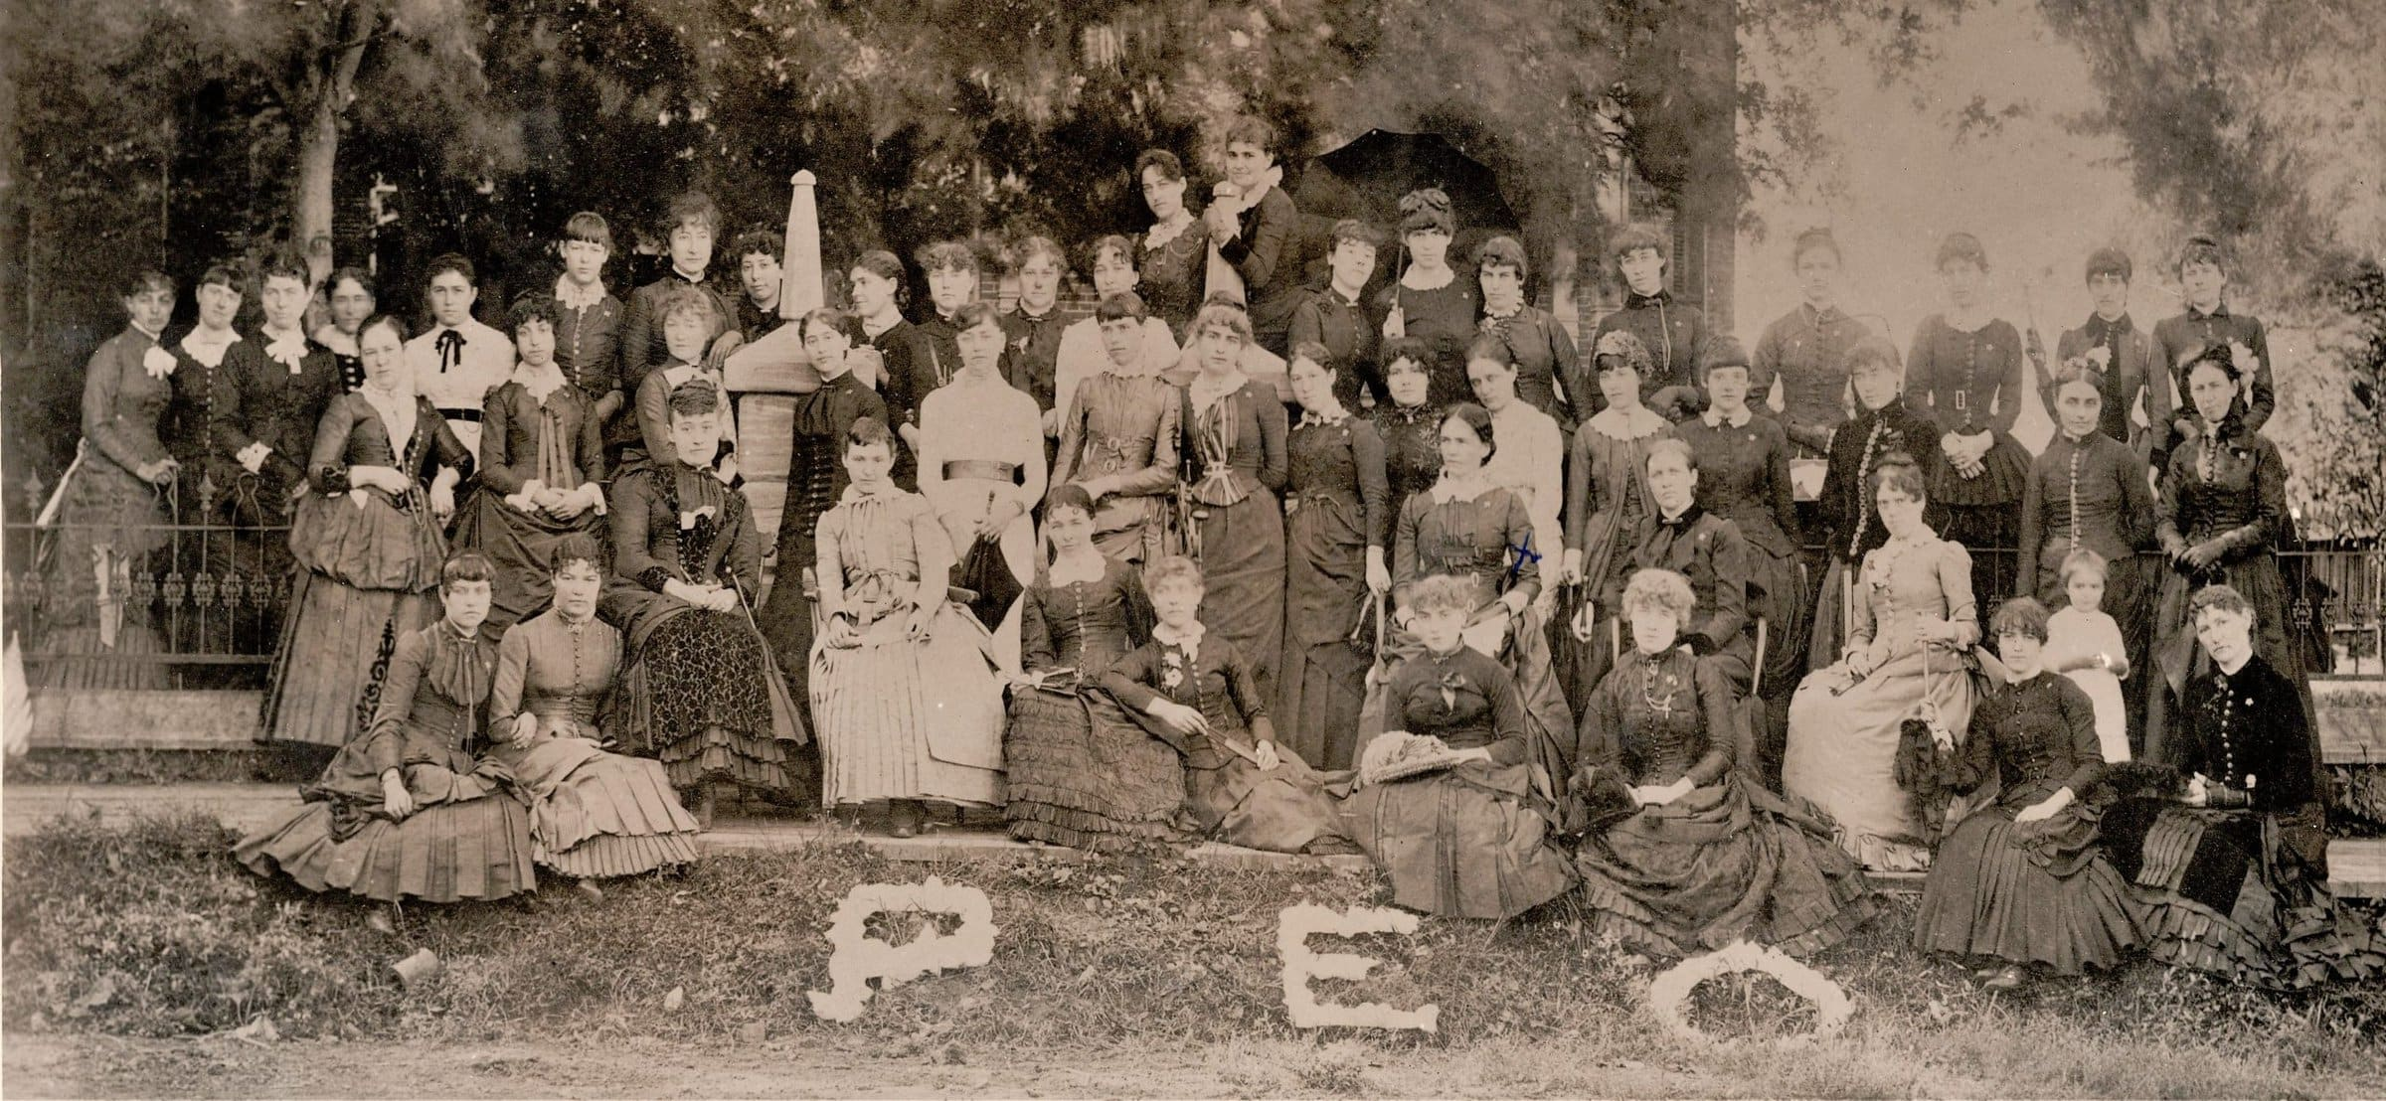
Love and Loyalty to Each Sister
First Convention of Grand Chapter in Centerville Iowa - 1884
7

Slide 8
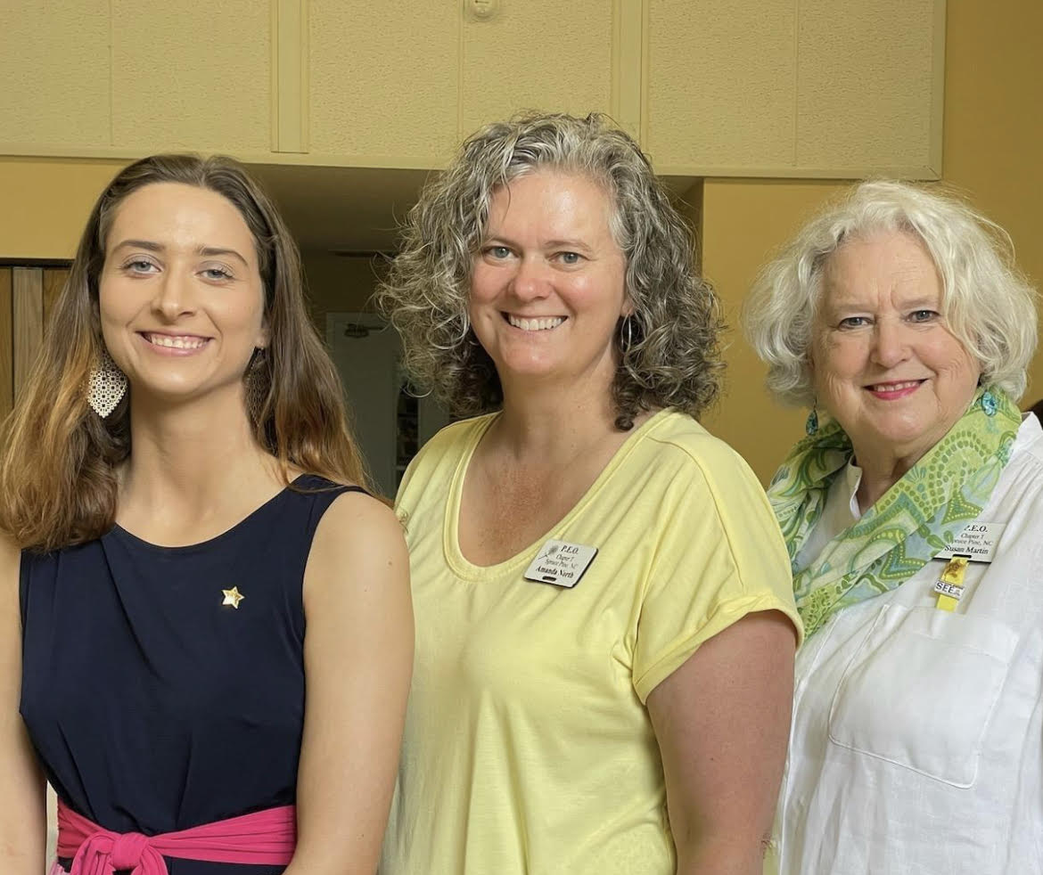
Active Sister
Current in the payment of her dues
She is a member of a local or state chapter
Could be unaffiliated
She may or may not be participating in chapter life

Slide 9
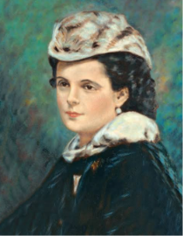
Inactive Sister
Not current in the payment of dues
Is not participating in business, may
attend social and other events
Is an inactive member of the chapter
Suela Pearson, Founder

Slide 10

Reinstated Sister
Is Inactive and would like to re-start her membership
May be re-joining the same chapter
May be reinstating and joining another chapter – this move would include transferring

Slide 11
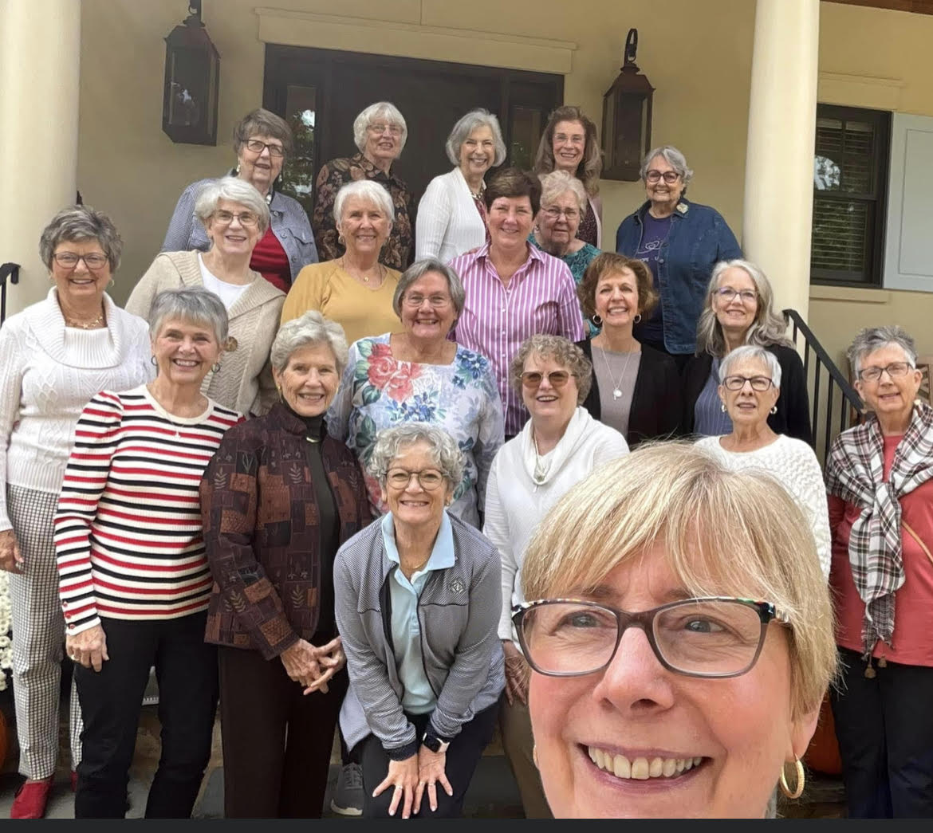
Transfer Sister
Used to be called “demit”
Active sister moves from one chapter to another
Could be unaffiliated
Can be from another NC Chapter or can be a member in a chapter from another state

Slide 12

Chapter Eternal
Always a P.E.O.
We celebrate all sisters, active or inactive
LOVE!

Slide 13
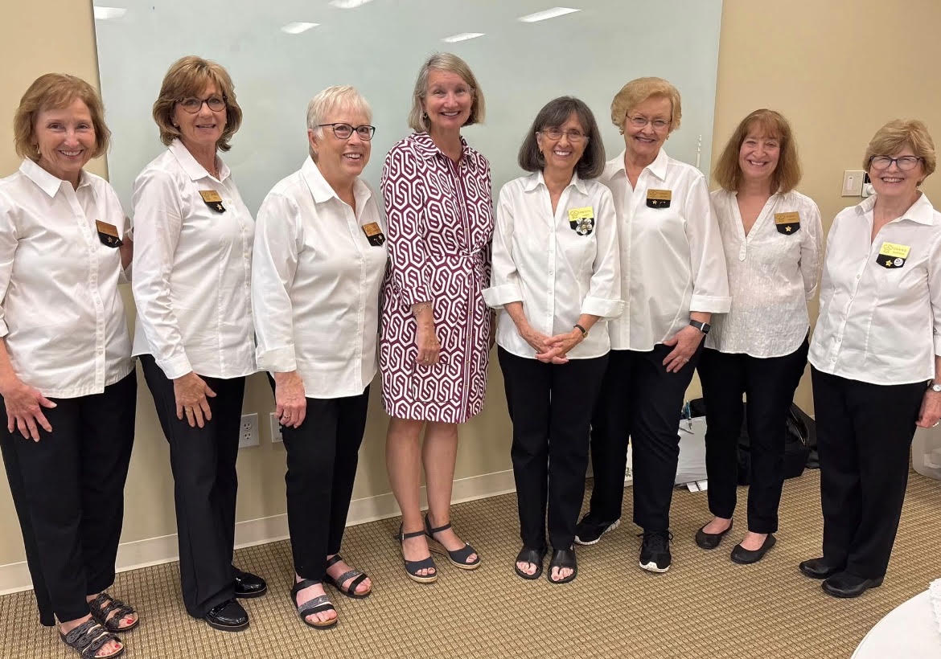
Initiate!
New Sister!
Starting her
P.E.O. Life!
LOVE!

Slide 14
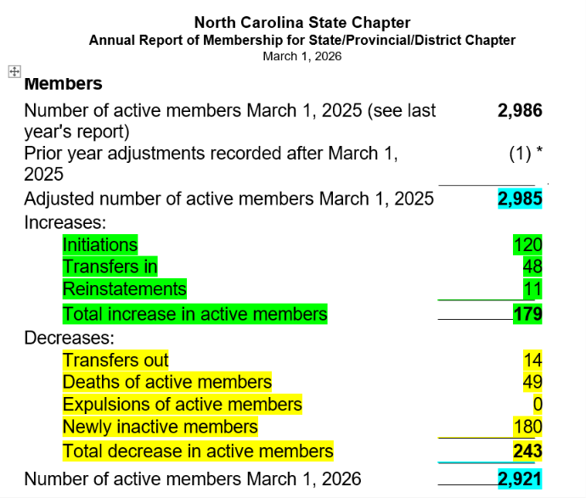
243-179= 64
2985 – 64= 2921

Slide 15
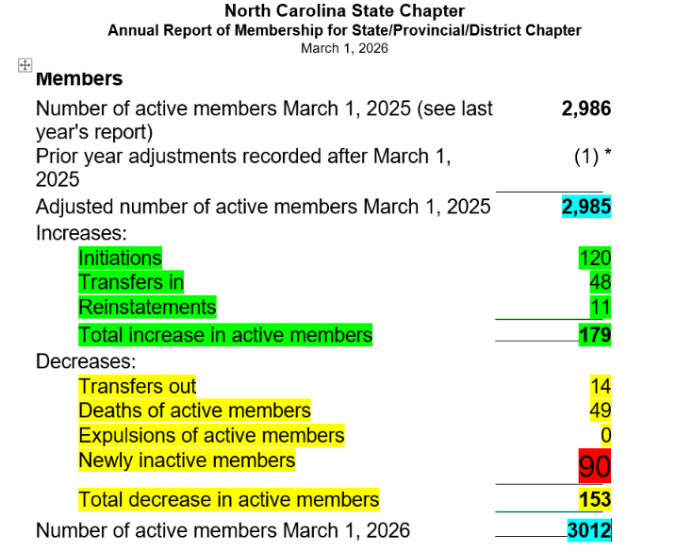
179 – 153= 26
2985 + 26= 3012

Slide 16
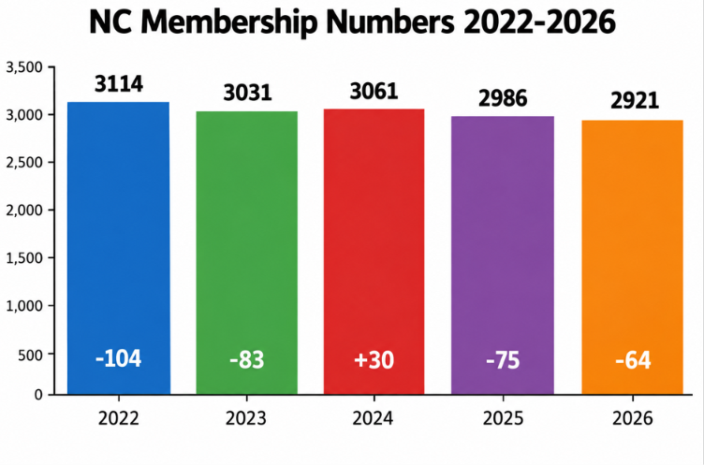

Slide 17
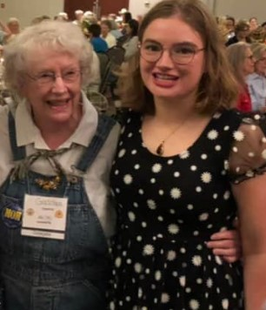
What else can we learn from the Numbers?
Steady Flow of new women
New commitment brings new ideas and energy
Many Marguerites make light work
Connection

Slide 18
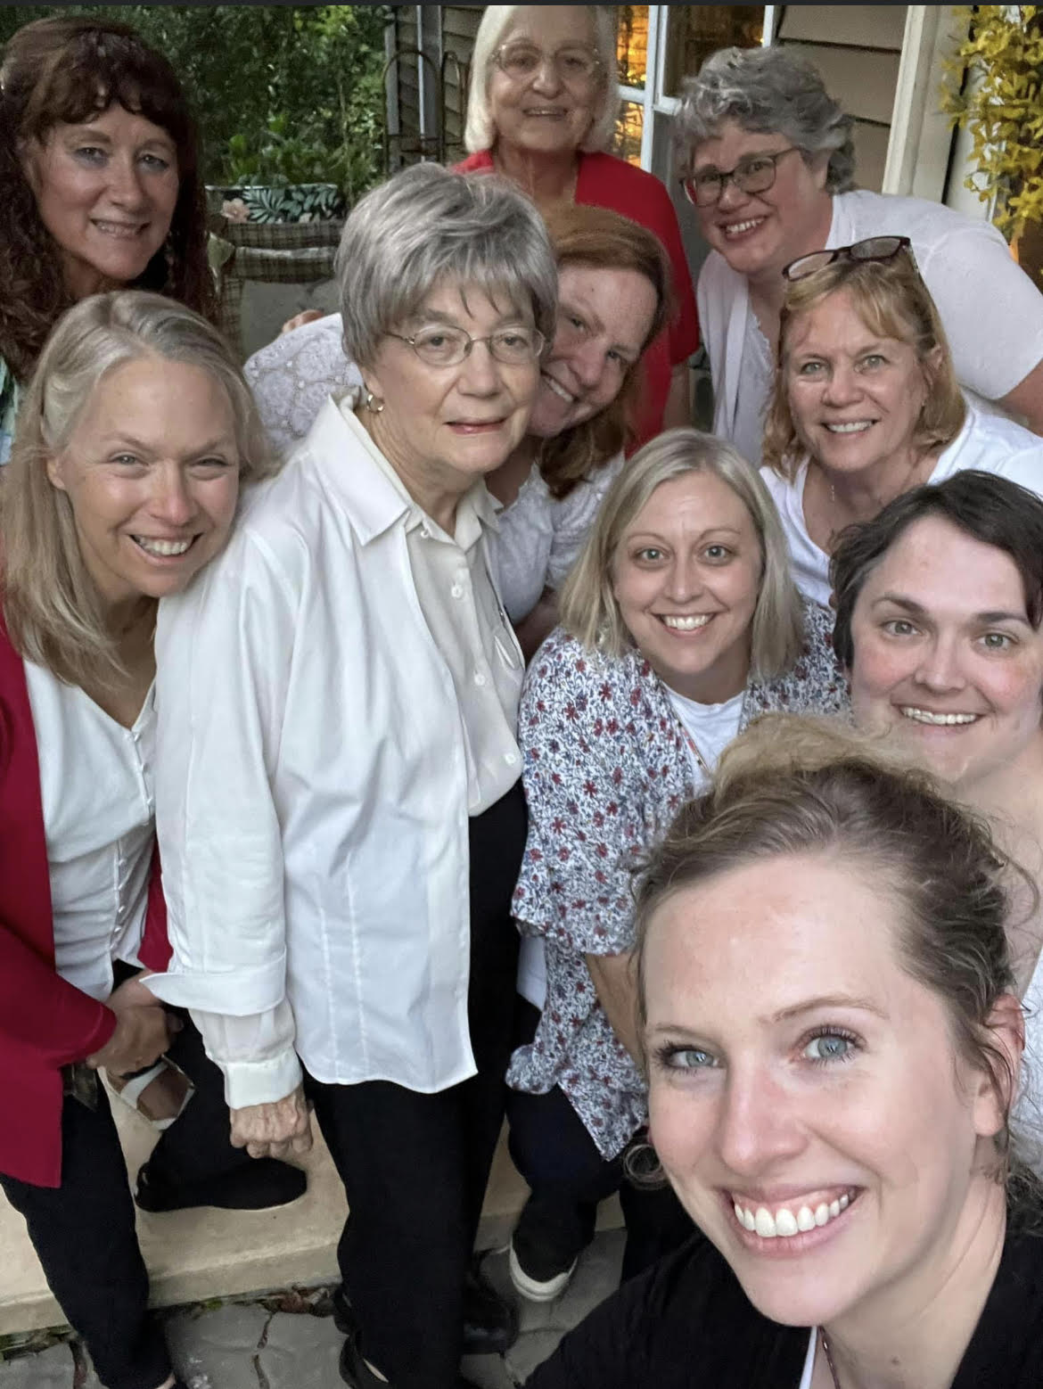
Exploring Inactive Status
Some sisters going inactive is unavoidable
Some sisters that go inactive can be unpredictable
Engaging may prevent inactives
Trusting and Safe environment creates Joy and Commitment
Thriving
Build a
Culture Connection

Slide 19


m&m Challenge 2.0
Wildly Important Goal
m&m Challenge is Engaging!
Fall in love with P.E.O. again and again!

Slide 20
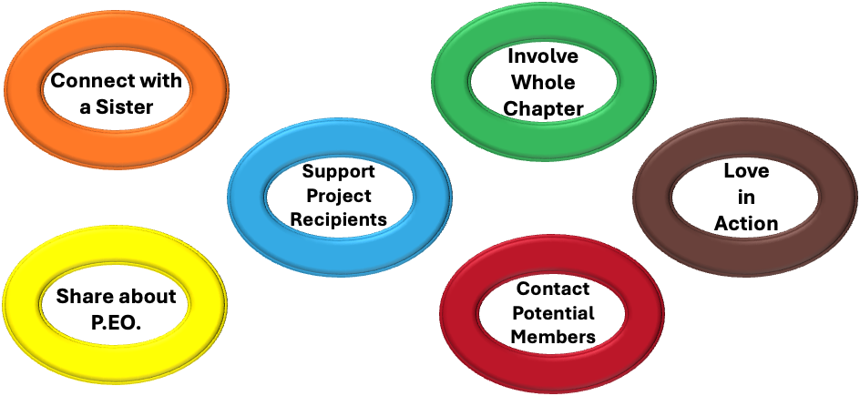
m&m Challenge 2.0

Slide 21
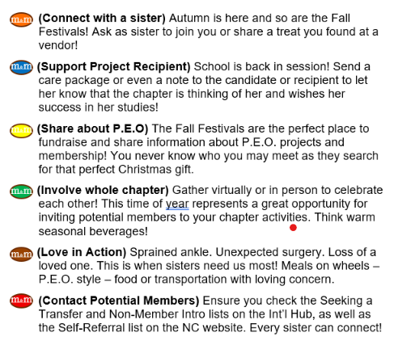

Slide 22
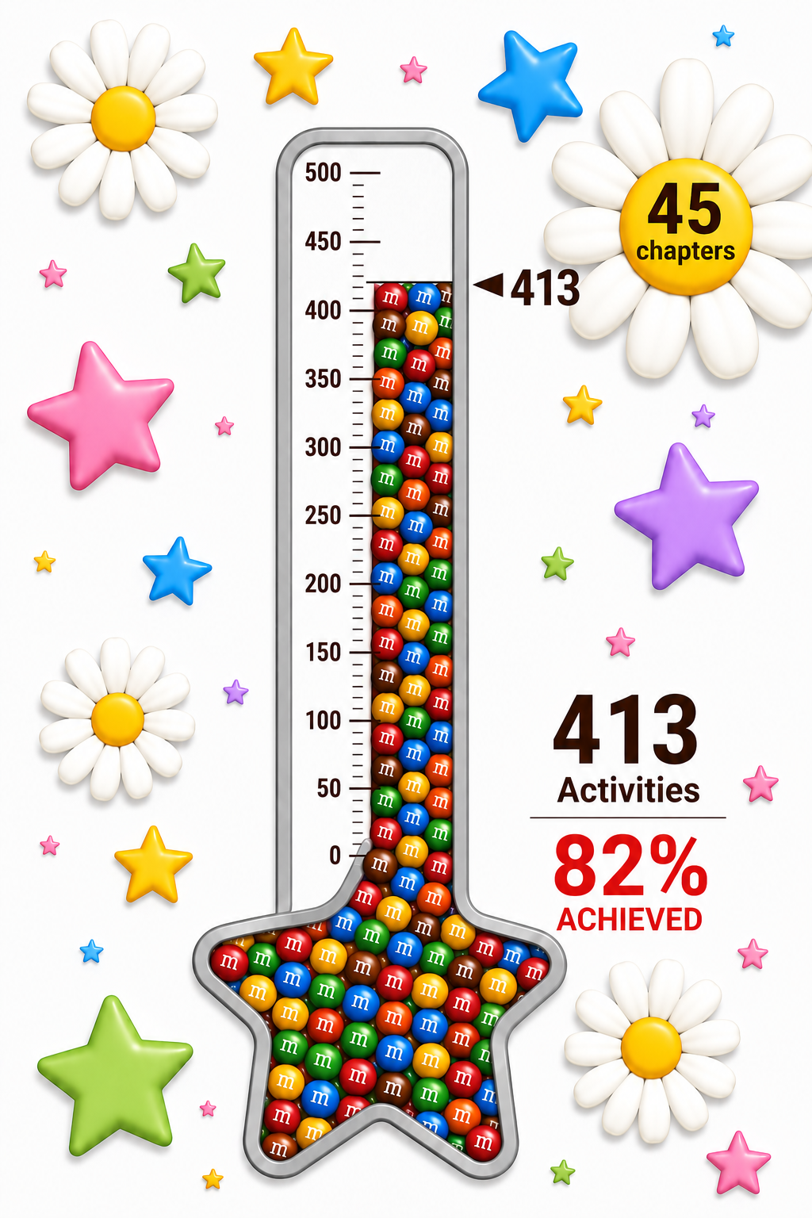
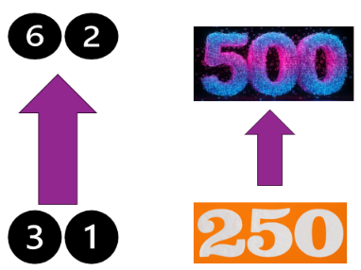
m&m Challenge 2.0

Slide 23

Zero Loss or Growth Year
Start: 2,985 active sisters x 10% = 290
  Chapter of 30 active sisters – increase of 3
Decreasing Inactives by 20% (from last last year’s 180) 40 or - 140
  180 x 20% is 40. 180 – 40 = 140
290 – 140 – 40 (chapter eternal) = 110!
  Transfer in and out a wash
That is a HUGE gain!

Slide 24

Zero Loss or Growth Year
Adjusted Scenario – 7 month “LOOK”
March 1 – September 30
Initiations = 79
Reinstatements = 12
Transfers In (from outside NC) = 21
Chapter Eternal = 16
79 +12 + 21 = 112 : 5 mo left : 4 months @ 16 and
1 month @ 13 (can’t transfer in February) = 93
5 months left - around 77 additional sisters
Expect at least 15 additional passing (31) Suggest 40
gain of 9 sisters!
189 – 40 = 149 – 140 = 9

Slide 25

Comments and Questions
Remember to unmute
We are answering from the Chat box first, then
Will take questions from raising your hand
Still Recording
25

