Slide 1

2026-2027
P.E.O. Sisterhood NC Chapter
Welcome!
Learn to Look
June 29 7pm – 8:15 pm

Slide 2

Facilitators
Jenn McDuff, Chapter AQ Asheville
Rhonda Stark, Chapter AI Kinston Data Coordinator on NC State Membership Committee
Kristin Tucker, “KT”, Chapter AG Chapel Hill
Teme Levbarg, Chapter BD Durham, Member of the Center of Excellence
Becky Murphy, Chapter AW Waynesville, NC State President
Sue Knape, Chapter C Charlotte, Chair NC State Tech Committee

Slide 3

Take Another Look
General improvement
Growth in charity
Obtain all possible wisdom
Use any talent we possess
Full import of P.E.O.
Under all circumstances show a loving concern

Slide 4

Move the Needle

Slide 5

One Degree Shift – Different Place

Slide 6

Increase Member Engagement
Increase Participation
Create Pipeline for Leadership
Increase Membership
Reduce Inactive Sisters
Support Chapter Vitality

Slide 7
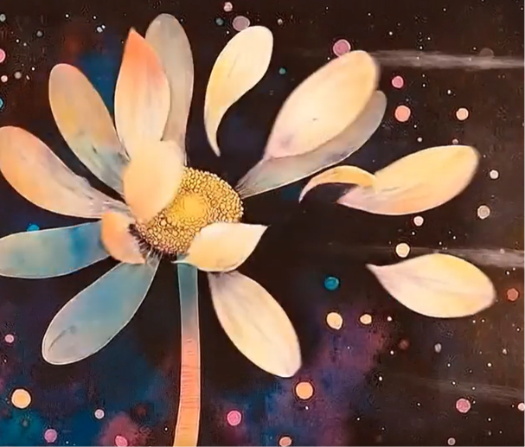
Pause…..
Recognize the Dead End
Take a Breath
You could say…….
That makes sense.
Many of us have done just that in
our families.
She is so interesting.
I love her.

Slide 8
Shift your Perspective
What Else is Possible?

Slide 9

Strengths!
What am I good at?
Strengths are Tools
What is my Advantage?

Slide 10
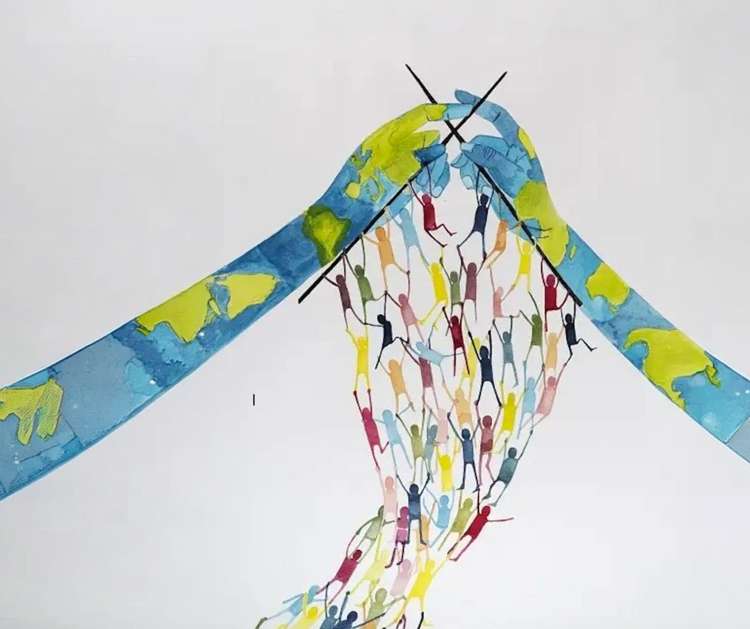
Simple Action
Don’t need a huge move
Small steps create
long-lasting change
Habits and a renewed culture are created

Slide 11

New Path
Actions Open the Door for Connection
You are Building Sisterhood

Slide 12


Slide 13


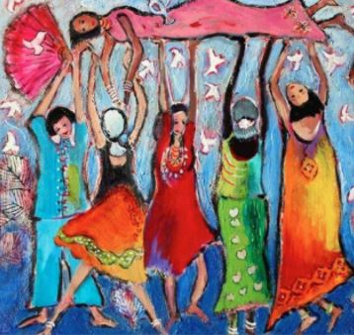

Outcomes
Connection
Engagement
Participation
Genuine Welcoming Culture
Commitment
Fewer Inactive Sisters

Slide 14
IMPACT Engagement

Slide 15
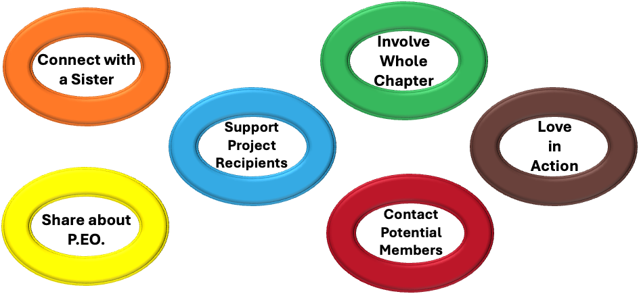
m&m Challenge 2.0 Categories

